Slide 1
Linear Algebra : Matrix operations in Data Science

Slide 2
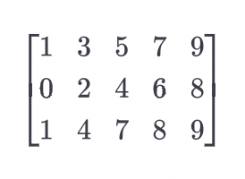
Matrices
Matrices are versatile mathematical objects that can be used to store and represent many different types of data.
They can store equations, geometrical transformations,, financial records.
Matrices are sometimes called data tables.
Matrices are indicated using bold-faced capital letters. The size of a matrix is indicated using (row, column) convention. For example, the following matrix is 3x5, because it has three rows and five column:

Slide 3
Linear Algebra: Matrix
Two main usage of Metrices in Data Science:
To store Tabular Data (Particularly data contained under “Quantitative Variable”)
“Matrix” is a foundation of Linear Algebra, and this is the “Language” of most Machine Learning Algorithms we use for analytical purposes

Slide 4
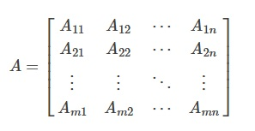
Matrix and Matrix Representation
Matrix is 1D, 2D,…,nD arrays of Values and a matrix with notation A ∈ R ^{m×n} with m rows and n columns will be represented as:

Slide 5
Special Matrices
Random Number matrix : This is a matrix that contains numbers drawn at random from some distribution.
Diagonal Matrix: A diagonal matrix has zeros on all the off-diagonal elements; the diagonal elements may also contain zeros.
Triangular Matrix: A triangular matrix contains all zeros either above or below the main diagonal.

Slide 6
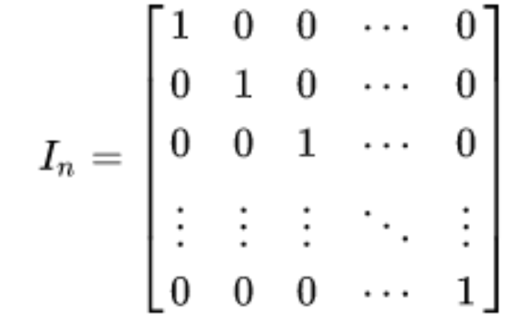
Identity Matrix
A special type of Matrix is Identity Matrix, which is a square matrix that always contains diagonal one “1” with rest of the other elements as zero “0”.

Slide 7
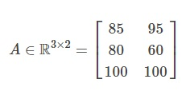
Representation of Data using Matrix
Student ID | CW1 Grade | CW2 Grade
34 | 85 | 95
20 | 80 | 60
14 | 100 | 100
Here, the “Student ID” column has not been included in the matrix representation as it’s not a numeric feature (Quantitative Measure).

Slide 8


Representation of Linear Equations using Matrix
Assume, following are the Linear Equations of two Variables: x₁ and x₂
Now, the equation can be represented as Matrix as an Equation Ax=b

Slide 9
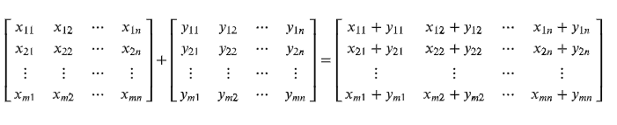
Matrix Addition
Matrix Addition is the element wise addition/difference of two Matrices.

Slide 10
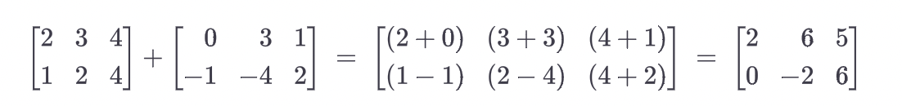
Example

Slide 11
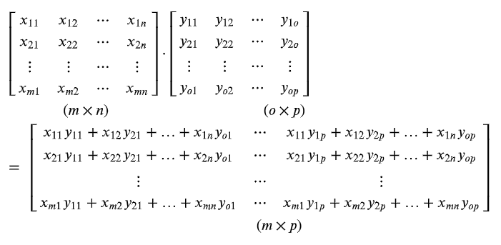
Matrix Multiplication
Matrix Multiplication (or,Dot Product) of two Metrices (i, j) element of the output matrix is the dot product of the i^{th} row of the first matrix and the j^{th} column of the second matrix.

Slide 12
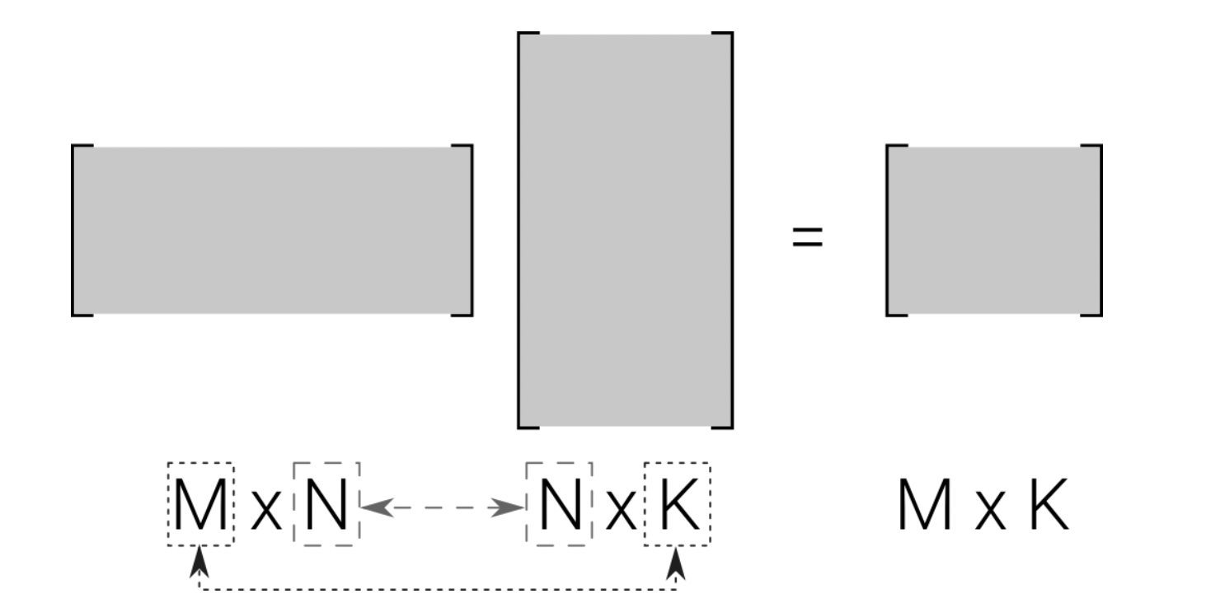
Rules for matrix multiplication validity
Matrix multiplication is valid only when the “inner” dimensions match, and the size of the product matrix is defined by the “outer” dimensions.

Slide 13
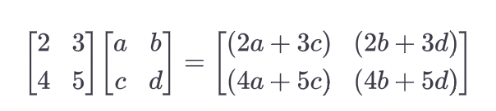
Example

Slide 14
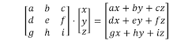
Multiplication between Matrices and Vectors
Multiplications between matrices and vectors will always be a dot product
The result will be another vector of 1 column and number of rows the same as both the matrix and the vector.

Slide 15
Example

Slide 16
Properties of Vector and Matrix Multiplication
Vector and/ or, Matrix multiplication is associative: (AB)C=A(BC)
Vector and/ or, Matrix multiplication is distributive: A(B+C)=AB+AC
Vector and/or, Matrix multiplication is not commutative: AB≠BA.

Slide 17
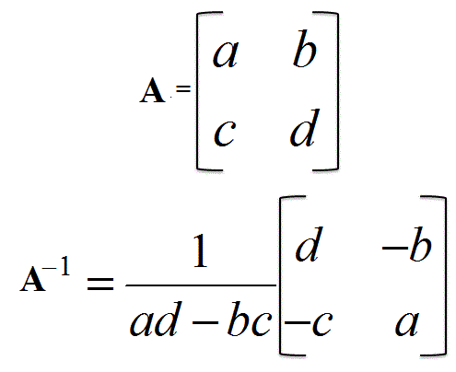
Special Operations of Matrix: Inverse Matrix
An Inverse Matrix is another matrix which, on multiplication with the given matrix produces an Identity Matrix.
That, means if A is the given matrix and if we determine A⁻¹ then, A.A⁻¹ = I, where “I” is an identity Matrix.
Here, the way to determine inverse matrix from any 2X2 Matrix is given:

Slide 18
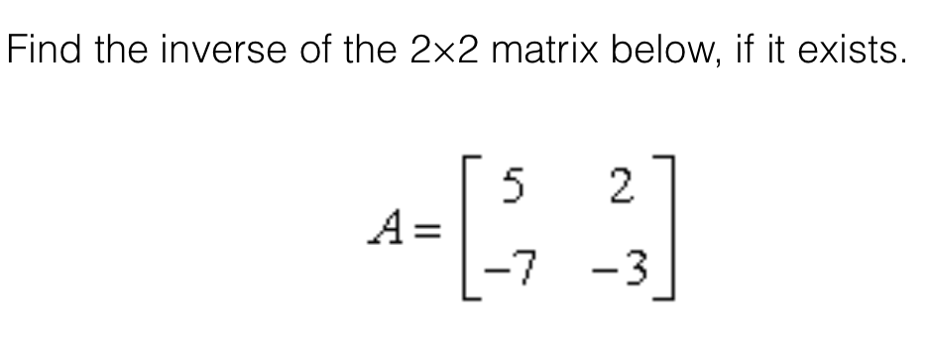
Example

Slide 19
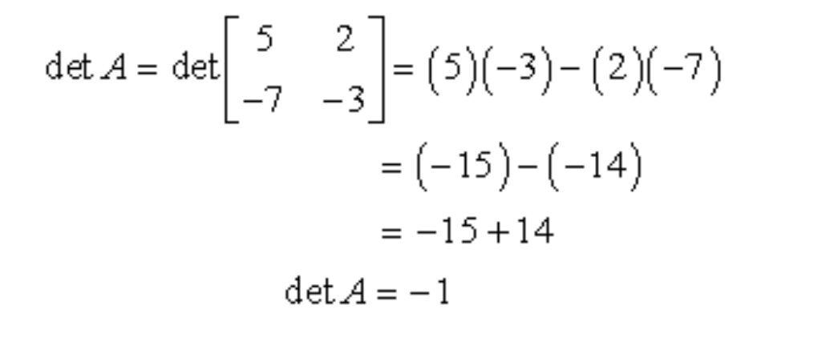
Solution
Determinant of matrix A

Slide 20
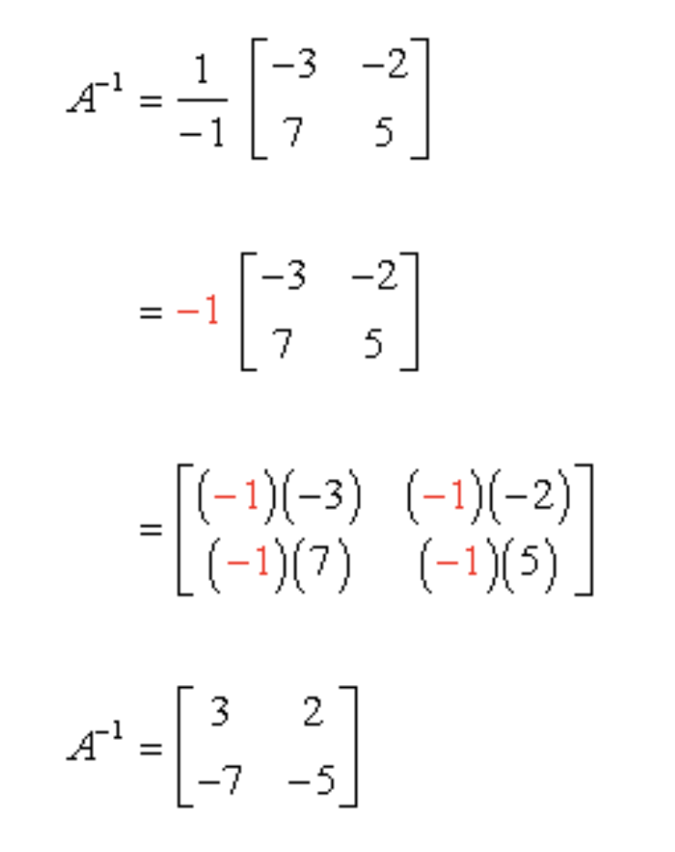
Inverse of matrix A is :

Slide 21
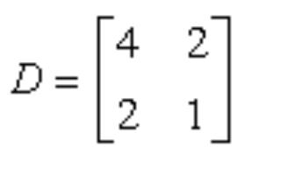
Example 2
Find inverse of the following matrix if it exists.

Slide 22
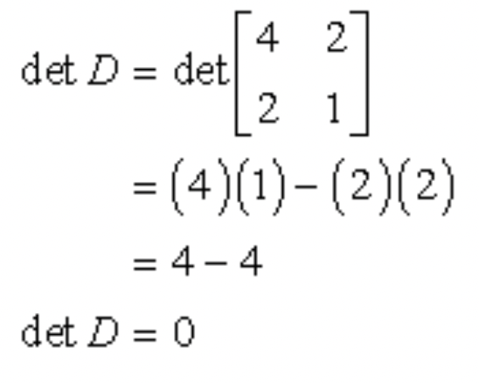
Solution
Since the determinant is 0, the inverse of this matrix does not exist.

Slide 23
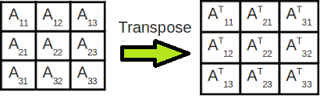
Special Operations of Matrix: Transpose Matrix
In Linear Algebra, a transpose of Matrix is an operation that flips the rows and columns of the Matrix, that means, this operation changes the rows of the Matrix into columns (and, equivalently the columns into rows).

Slide 24
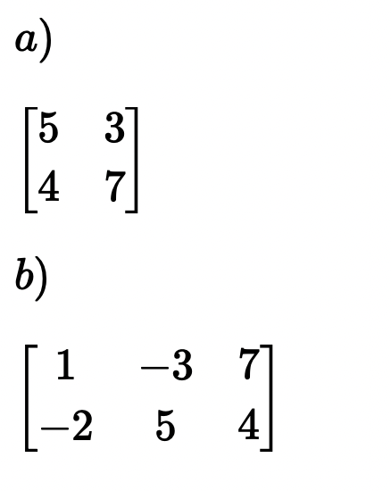
Examples
Find the transpose of the following matrices

Slide 25
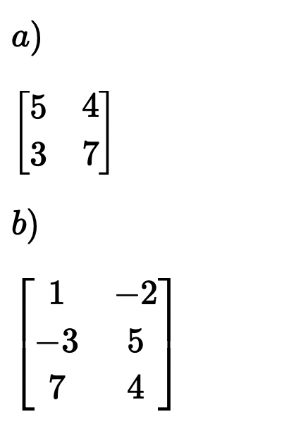
Solution

Slide 26
Solving equations using matrices : Converting equations into matrices
We can use matrices to solve systems of equations.
This can help us find the values of multiple unknown variables.
The first step is to convert the equations into a matrix.

Slide 27
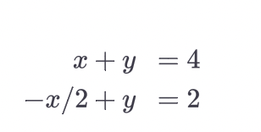
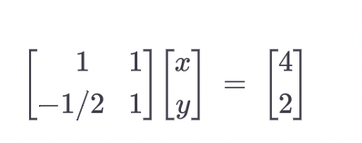
Equations
Matrix form

Slide 28
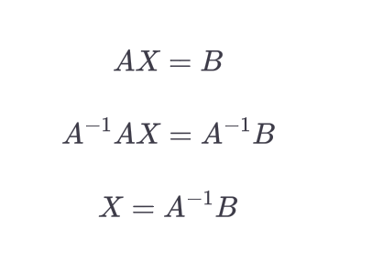
Using inverse to solve equations

Slide 29
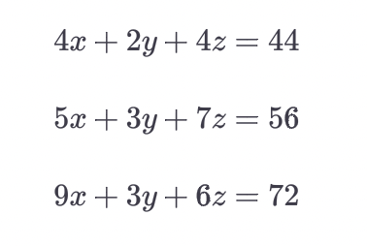
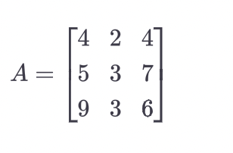
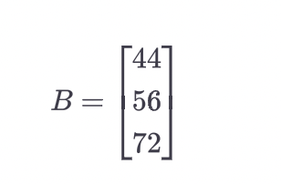
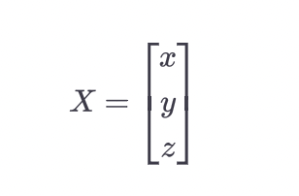
Example
Converting the equations in to matrices

Slide 30
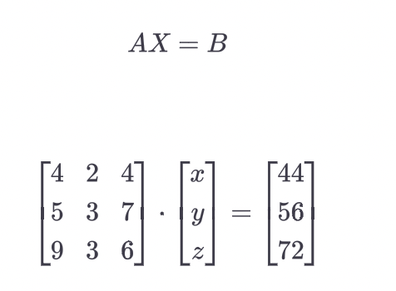
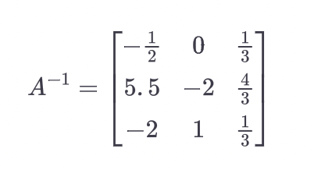
Calculating inverse of A gives you:

Slide 31
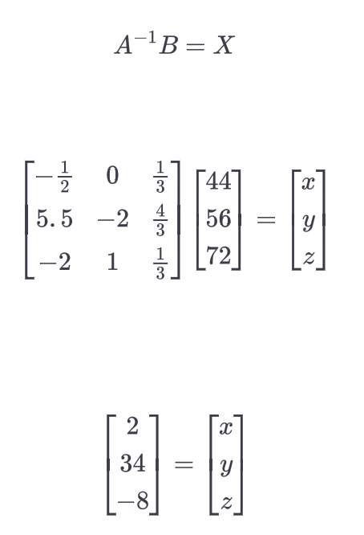
Solution:

Slide 32
Row Reduction
“Row reduction” means iteratively applying two operations to the rows of a matrix
Scalar multiplication
Addition
The goal of row reduction is to transform a dense matrix into an upper-triangular matrix.

Slide 33
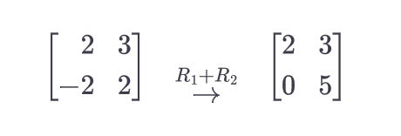
Transforming dense matrix into upper triangular matrix

Slide 34
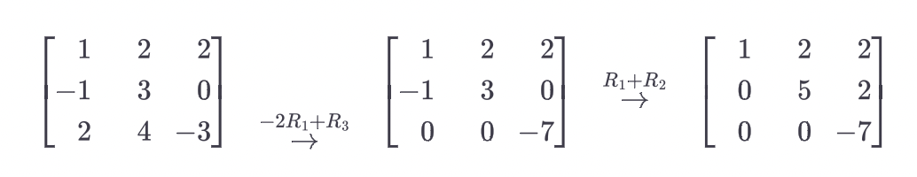
3 x 3 Matrix into Echelon form

Slide 35
Gaussian Elimination
3 steps of Gaussian Elimination are:
1. Augment the matrix of coefficients by the vector of constants
2. Row-reduce to echelon form
3. Use back-substitution to solve for each variable in turn.

Slide 36
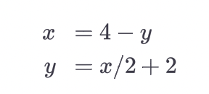
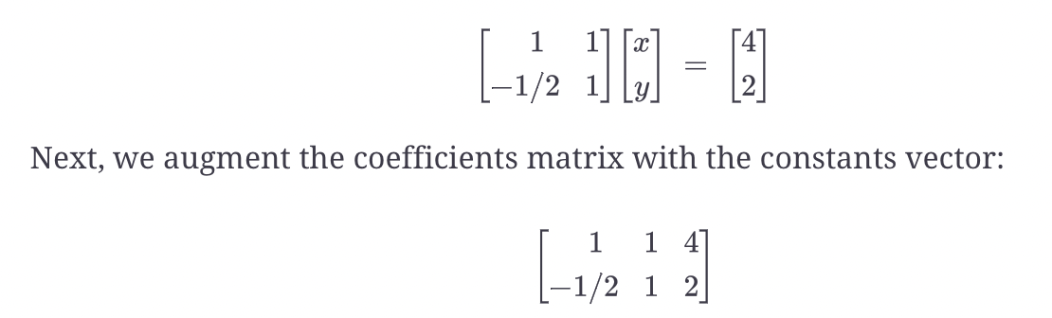
Example
Converting the equations into a matrix

Slide 37
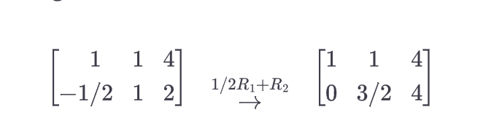
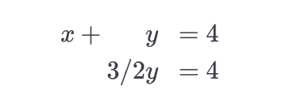
Row Reducing the augmented matrix
Translating the row reduced matrix back into system of equations

Slide 38
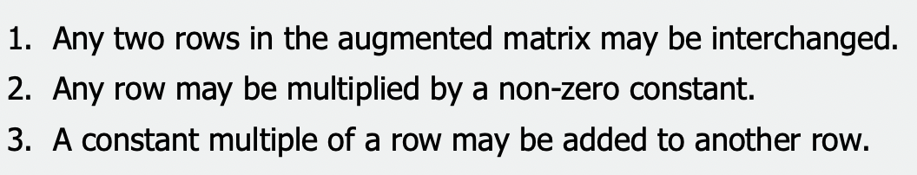
Gauss Jordan Elimination
In this method, you row reduce until you have 1s in the main diagonal and 0s everywhere else.
Once this is done, you do not need to use back substitution.
Row Operations

Slide 39
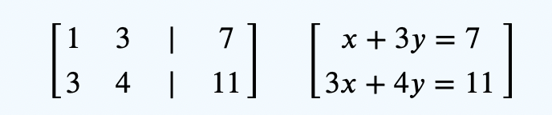
Example
Solve for x and y using Gauss Jordan method
𝑥+3𝑦=73
𝑥+4𝑦=11
The augmented matrix for the above equations is as follows

Slide 40
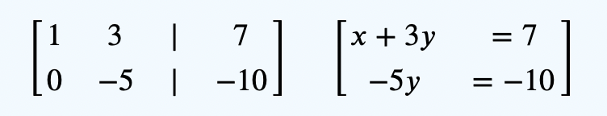
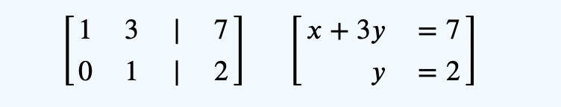
We multiply the first row by – 3 and add to the second row.
We divide the second row by – 5, we get,

Slide 41

Finally, we multiply the second row by – 3 and add to the first row, and we get,

